Slide 1
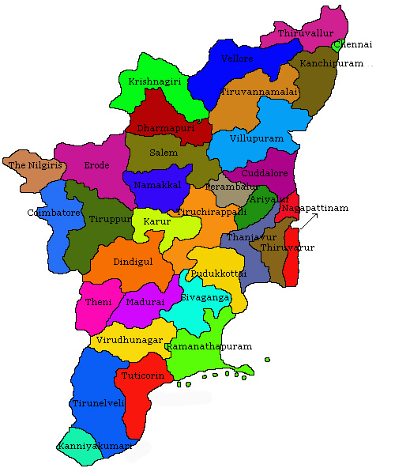
AIR QUALITY ANALYSIS IN TAMILNADU
Phase 1: Problem Definition and Design Thinking

Slide 2
Define Objectives
Clearly define the project's objectives, which you've already outlined as:
1
Analyze air pollution trends.
2
Identify areas with high pollution levels.
3
Develop a predictive model for RSPM/PM10 levels based on SO2 and NO2 levels.
4

Slide 3
Data Collection and Preparation
Collect
Collect historical air quality data from monitoring stations in Tamil Nadu. You can obtain this data from governmental agencies or open data sources.
Clean and preprocess
Clean and preprocess the data, handling missing values, outliers, and formatting issues.
Ensure
Ensure that the data includes relevant features such as timestamp, location, SO2 levels, NO2 levels, and RSPM/PM10 levels.

Slide 4
Exploratory Data Analysis (EDA)
Perform EDA to understand the data better.
1
Calculate basic statistics, visualize distributions, and explore correlations between variables.
2
Create summary statistics and visualizations to highlight pollution trends over time and space.

Slide 5
Data Visualization
Use Python libraries like Matplotlib, Seaborn, and Plotly to create informative visualizations.
01
Consider creating time series plots, heatmaps, geographical maps, and scatter plots to visualize pollution trends, spatial patterns, and relationships between variables.
02
Use color coding and interactive elements to make your visualizations more informative.
03

Slide 6
Identify Pollution Hotspots
Utilize geographical plotting or heatmaps to identify regions with consistently high pollution levels.
Cluster analysis or spatial mapping can help pinpoint specific areas of concern.

Slide 7
Predictive Modeling
Split
Split your dataset into training and testing sets.
Use
Use regression techniques (e.g., linear regression, random forests, or gradient boosting) to build a predictive model for RSPM/PM10 levels based on SO2 and NO2 levels.
Evaluate
Evaluate the model's performance using appropriate metrics on the testing dataset.

Slide 8
Fine-Tuning and Feature Engineering
Experiment with feature engineering techniques to improve model performance.
Fine-tune hyperparameters and consider trying different algorithms if necessary.

Slide 9
Interpret Results
Interpret the model results to understand the impact of SO2 and NO2 levels on RSPM/PM10 levels.
Identify significant trends or relationships and their implications.

Slide 10
CONCLUSION
Insights Derived: Summarize the key findings from the data visualization and analysis.
1
Model Findings: Discuss the performance of the predictive model, its strengths, and limitations.
2
Recommendations: Based on the insights, recommend actions to stakeholders, e.g., areas that need more stringent pollution controls.

